Slide 1
TU Commuter App Case Study

Slide 2
Problem
Commuting college students have to deal with fragmented information regarding getting to class. Important information like traffic flow, a campus map, parking availability, and class schedules are all found in their own app or website. Students need a single reliable tools that’s brings all travel related information together in order to plan their day efficiently. My app aims to solve this by combining all of these into one easy to use system.

Slide 3
Solution
The solution is to make an all-in-one commuter app that brings Google Maps routing, parking availability, campus parking maps, and your class schedule together.
Features
Map with shuttle routes, current traffic, and parking lots near your class building
Traffic flow graph showing current and recent traffic levels
Live parking lot availability with currently open spaces shown
Campus parking map showing lots near the building your classes are in
Schedule integration that reminds you when you should leave based on your distance from campus and traffic levels

Slide 4
Design Choices
Colors
The colors are the pantones from Towson’s branding page since this app was designed specifically for Towson students.
Font
Akatab
A sans-serif font was needed to keep the design of the app clean, approachable to users young and old, while still keeping the “Towson feeling” to it.

Slide 5
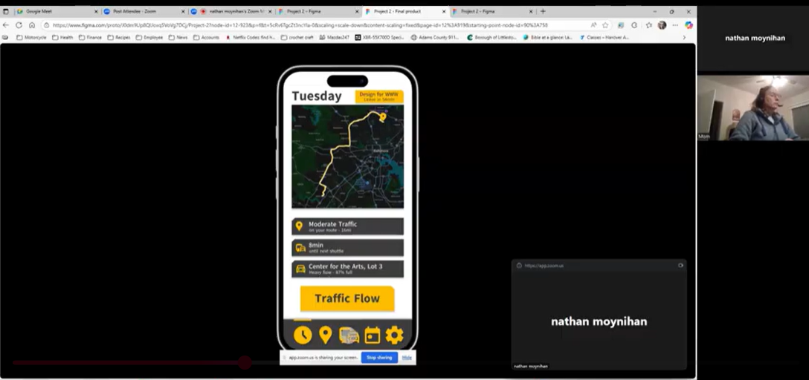
Usability Test 1
Age: 61
Drives regularly for errands and appointments, familiar with busy roads.
Doesn’t like switching between multiple apps
Wants a straightforward interface that clearly shows traffic and where to park.
https://youtu.be/KUceSc_KrVM?si=cl-eoOYgEy3JM2Fy

Slide 6
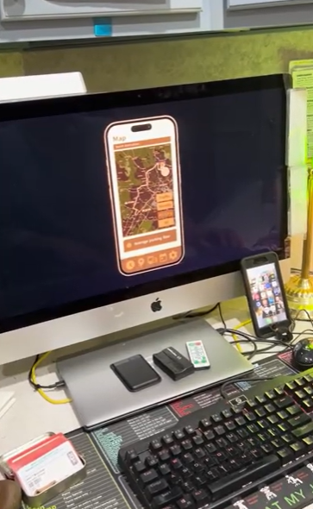
Usability Test 2
Age: 71
Only drives when needed
Limited app usage, mainly relies on Google Maps
Overwhelmed by cluttered or visually busy apps
Needs a clean layout with minimal steps to check traffic
https://youtu.be/PhCtEgy0L94?si=sPAaU0s00ssKjxwi

Slide 7
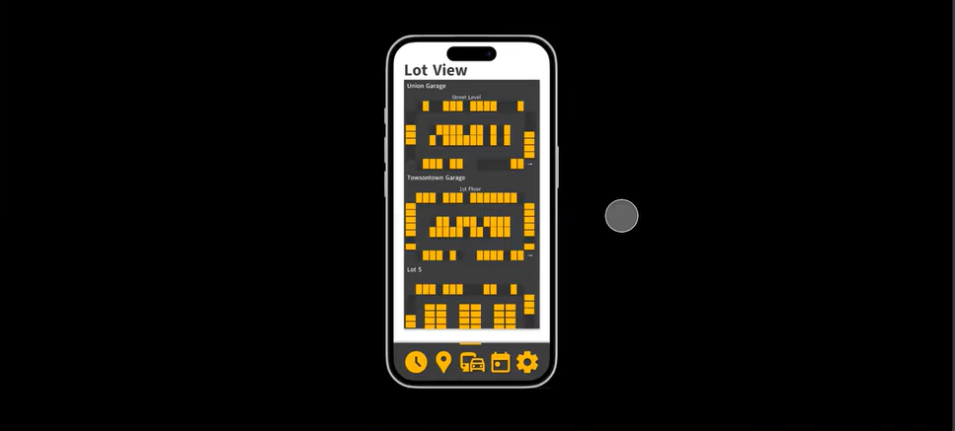
Usability Test 3
Age: 20
Drives to campus daily, deals with heavy traffic and difficult parking
Comfortable with mobile apps
Doesn’t like uncertainty and timing commutes around class schedule
Needs an all-in-one solution
https://youtu.be/C5BgtHmqRYE?si=5IgQnooDLpjRjjY7

Slide 8
Findings
What worked
The overall design language worked for users, and they were easily able to understand what each page was showing to them.
What didn’t work
Users struggled to change destinations since it wasn’t clear that they changed it.
Users didn’t understand that you could swipe through the different floors of the parking garage lot view screen
It wasn’t clear which spots were taken, and which weren’t.

Slide 9
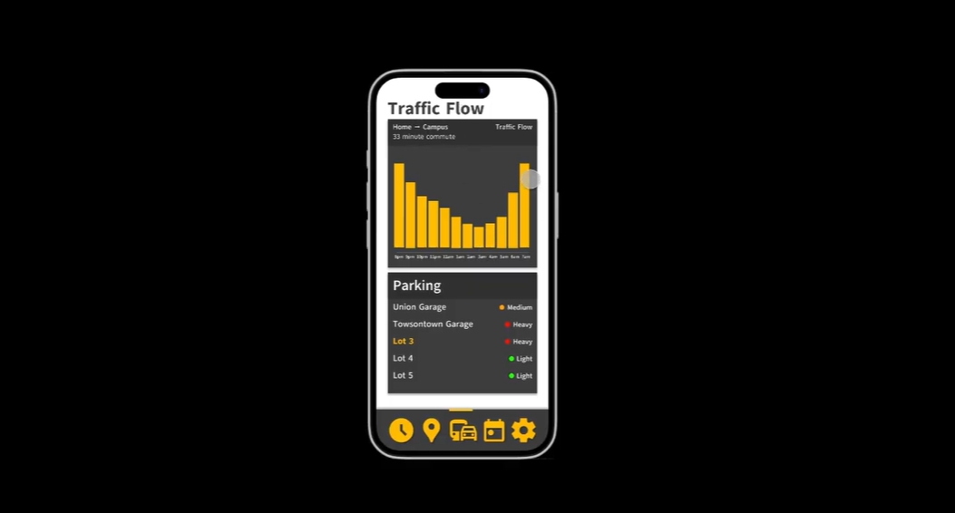
App walkthrough
https://youtu.be/LW7A97WSyPg?si=kN6S7jLZJXH6XZPX

