Slide 1
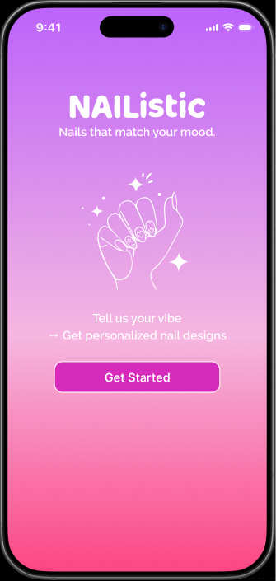
NAIListic
Your Mood-Driven Nail Design Studio
Huu Nhu Nguyen Le - ART 365

Slide 2

What Problem Are We Solving?
Users want beautiful nails but don’t know which design matches their mood or style.
Existing apps rely heavily on static catalogs, lacking personalization.
Users can’t visualize how a nail design looks on their actual hand before committing.
They often struggle to find the right nail artist nearby who can execute the design.

Slide 3
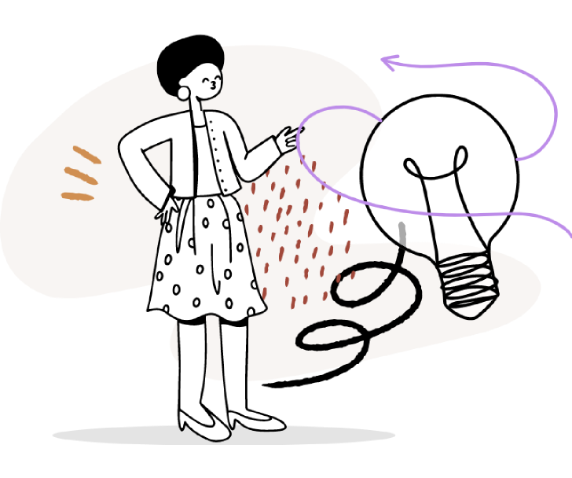
How NAIListic Solves These Problems (Selling Points)
Converts user mood into personalized nail designs using the MoodSync AI Engine.
Allows users to preview the designs on their real hands through AR.
Matches users to the most suitable local nail artist based on skill, proximity, and design requirements.
After selecting an artist, users can book an appointment directly within the app with a simple, guided flow.
=> All steps happen seamlessly inside the NAIListic app — no need to browse Pinterest for nail ideas, save screenshots, or search Google for salons and phone numbers to call.

Slide 4
Color Scheme Choices
#D22CD8
#FD61CB
It creates a fun, modern, and youthful atmosphere that encourages users to explore their feelings through design.
Supports the app’s core identity: personalization + self-expression
Creates a cohesive and immersive mood-centric experience
Ensures that nail designs remain the main visual highlight
Conveys both beauty (pink tones) and technology (purple tones)
#882EC4
#F4DBFF
#BD5DFE

Slide 5


Fonts Used
Milky Nice
(App name on Onboarding page)
Raleway
(Titles, main buttons)
Inter
(body text)

Slide 6
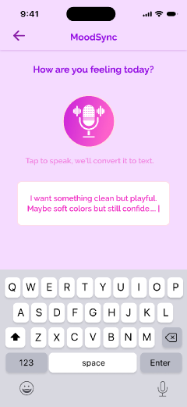
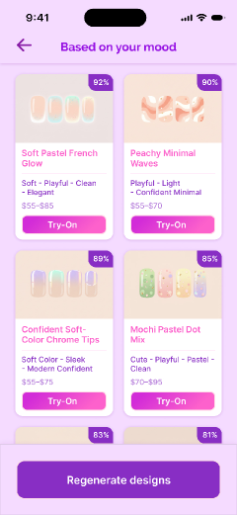
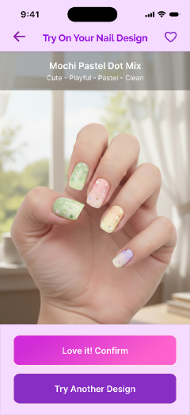
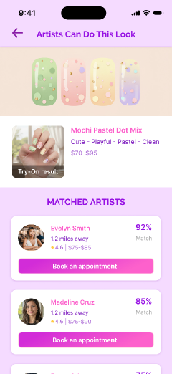
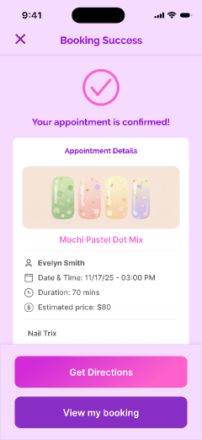
The Seamless Nail Journey
The only app combining four steps into one fluid journey
Emotion → Creation → Visualization → Artist Selection → Execution

Slide 7
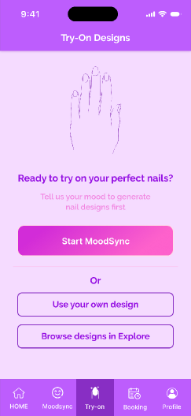
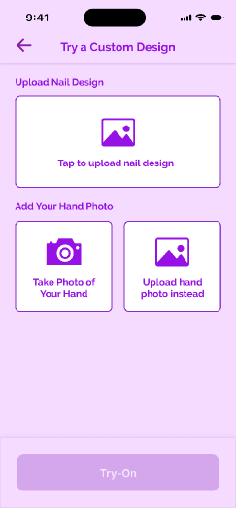
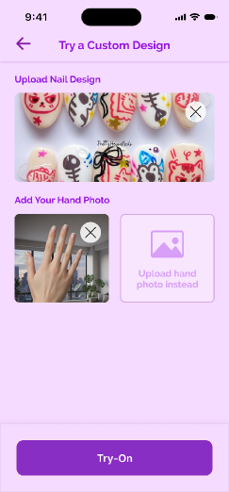
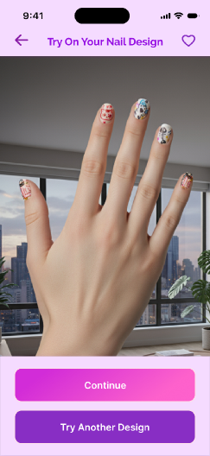
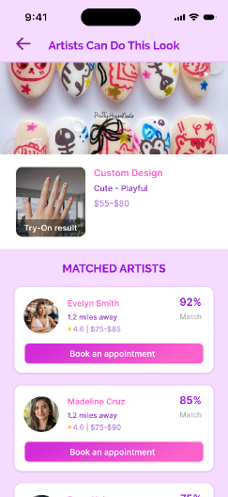
Other features
Try your own nail design without typing your mood

Slide 8
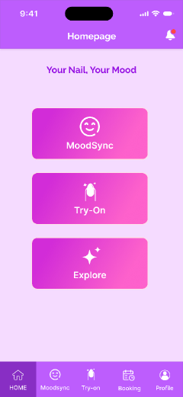
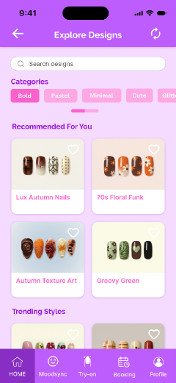
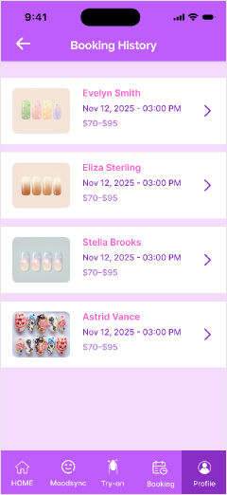
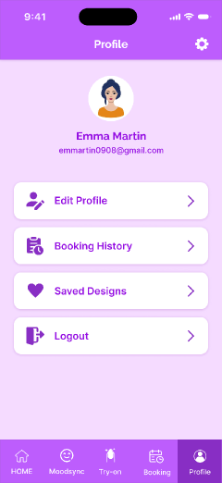
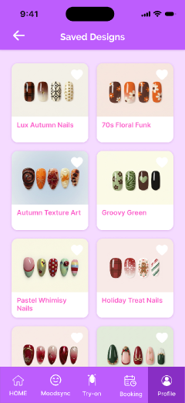
Other screens
Homepage
Explore
Booking History
Profile
Saved Designs

Slide 9
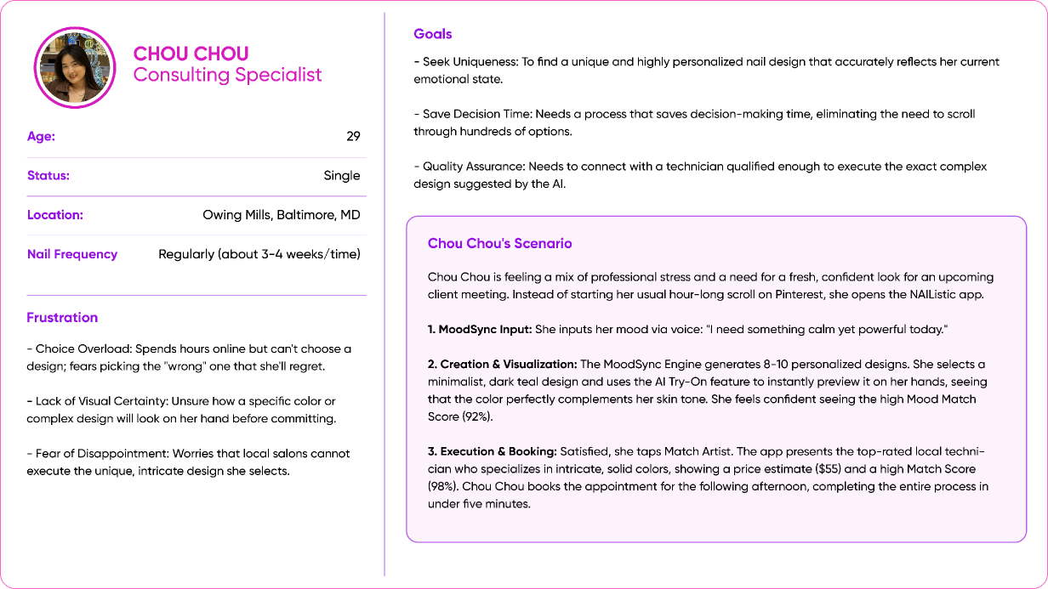
First user - Chou Chou
1
Youtube link:
https://www.youtube.com/watch?v=U6nOYbJkKV0&t=102s

Slide 10
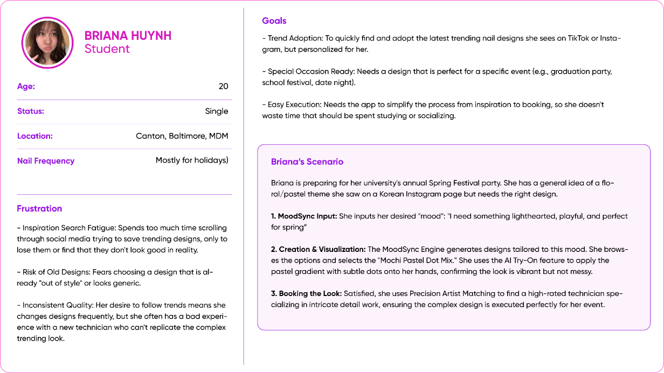
Second user - Briana Huynh
2
Youtube link:
https://www.youtube.com/watch?v=6d_GVBJw1uI&t=25s

Slide 11
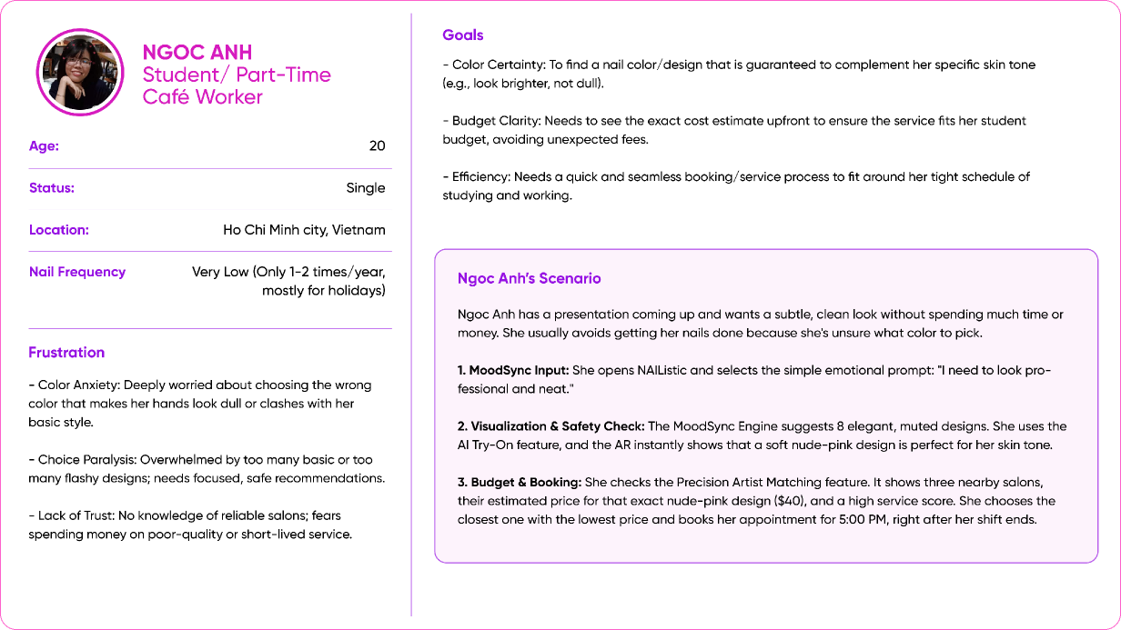
Third user - Ngoc Anh
3
Youtube link:
https://www.youtube.com/watch?v=6X8bXEQ-aro&t=136s

Slide 12
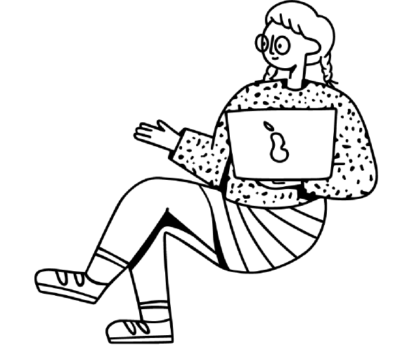
Usability Tests - Results
After several rounds of user testing, I've identified a few areas that need improvement:
A dedicated screen should be added to suggest the complete list of available nail artists in the user's local area.
A confirmation pop-up screen needs to be added for appointment cancellation (in case the client decides to cancel their scheduled appointment with the nail artist).
Most users wanted to be able to click on all clickable buttons to navigate to other pages. However, since this is a prototype, I couldn't meet this demand. I will update and add these supplementary screens if I had more time.
=> These are the issues that need fixing. Apart from these, users generally provided positive feedback on the overall interface, stating that it looks appealing and clean.

Slide 13
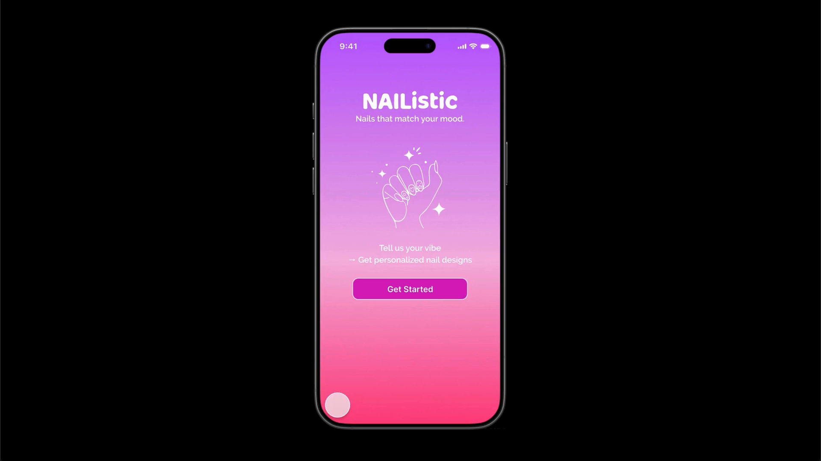

Slide 14
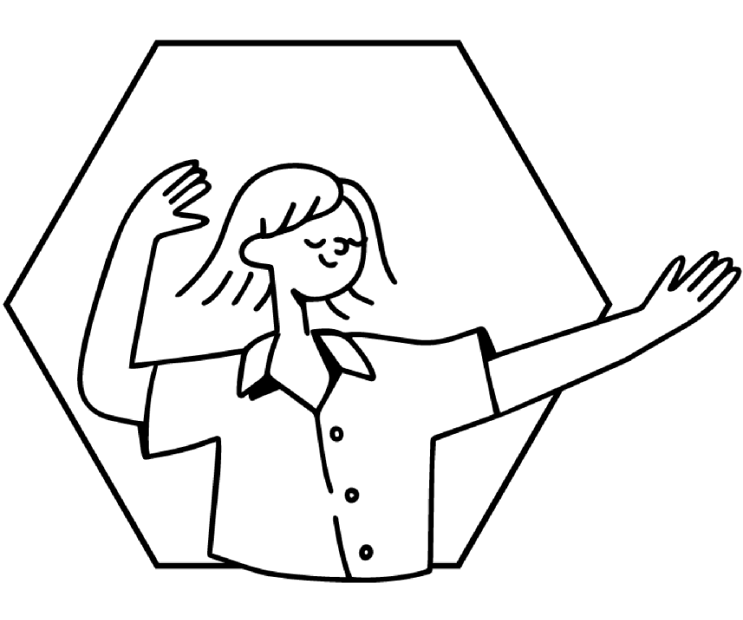
Thank you!
Case Study Presentation
hle12@students.towson.edu

